Slide 1



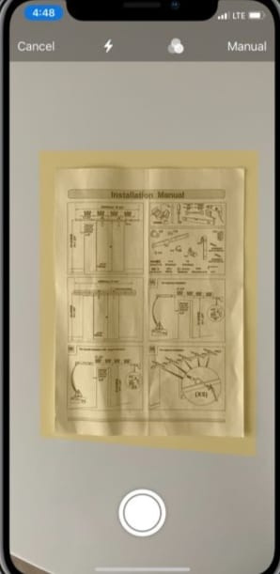



SNAP SEARCH
Where questions meet answers, instantly!

Slide 2


PROBLEM STATEMENT
Develop an innovative application that extracts text from image and displays answers respective to the extract.

Slide 3
Our application is designed to make it easy to extract text from images and display it in a user-friendly window. Whether you need to digitize a document or capture text from a photo, our app makes it simple and intuitive.
Our team is dedicated to creating an application that is both powerful and easy to use. We believe that everyone should have access to the latest technology, and we are committed to making our app affordable and accessible to all.
About the Application

Slide 4
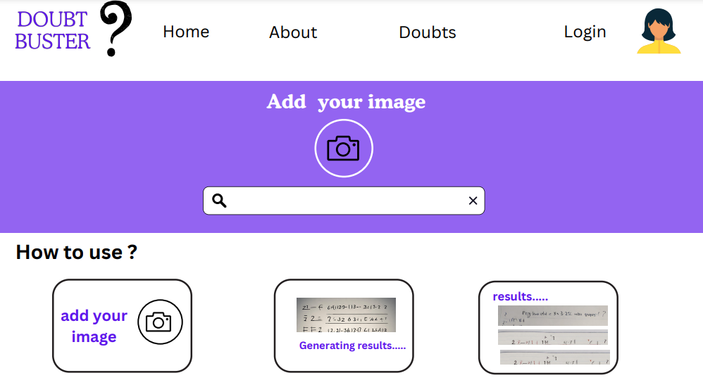
Technical Specifications
Compatible with Windows and macOS operating systems
Supports multiple image file formats, including JPEG, PNG, and BMP
Uses advanced OCR technology for accurate text recognition
Allows users to edit and save output text files in various formats, including TXT, DOC, and PDF

Slide 5
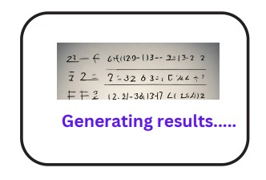
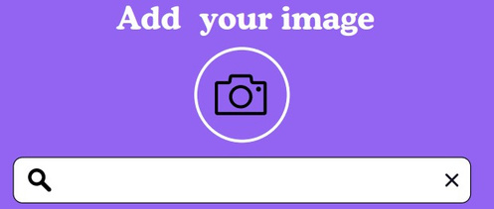
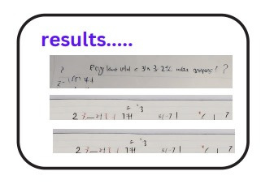
HOW IT WORKS
UPLOAD IMAGE
SCAN TEXT
OUTPUT DISPLAY
THE USER UPLOAD THE IMAGE CONTAING THE QUESTION
THE APPLICATION USER OCR TECHNOLOGY TO SCAN THE TEXT FROM THE UPLOADING IMAGE
The scanned text is displayed in a user-friendly window for easy viewing and editing.

Slide 6
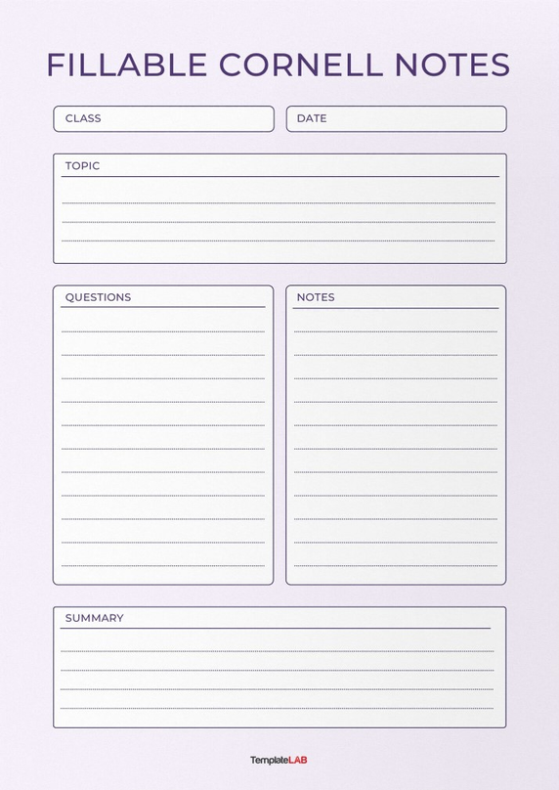
UNIVERSITY CERTIFIED NOTES
Simple And Coherent Notes
The notes provided are easy to understand which are presented in a simple and require little effort to understand.
Certified Notes Document
These notes are verified by the Boards and are produced by professional faculty and teachers.

Slide 7

DATA ROOTS
Data resources are taken from 1st and 2nd year synopses which are common in every university. These synopses are verified by the university authority and given to you in an understandable manner.

Slide 8
SNAP SEARCH
PROBLEMS
SOLUTIONS
VALUE PROPOSITIONS
CUSTOMER RELATIONSHIPS
CUSTOMER SEGMENTS
Develop an innovative application that extracts text from image and displays answers respective to the extract.
Snap Search is a platform that utilizes OCR technology to quickly scan and provide accurate and easy-to-understand answers.
The target customer segments are:
Students: student can use the application to get precise answers and they can use this application for rearch.
Hobbyists: Hobbyists can use an application to quickly find information about the subject there are want to know.
Provide a number of value propositions like
Convenience
Accuracy
Efficiency
Expertise
Responsive to customer inquiries, resolving customer issues quickly and efficiently, and providing customers with a positive overall experience.
EARLY EXPERIMENTS:
CHANNELS
Traditional search methods are time-consuming and often yield irrelevant or complex results.
Launch a beta version of the application to a limited number of users and collect feedback.
Promote the application on social media and through online advertising.
Partner with schools and businesses to offer the application to their students and employees.
The image scanning application would be available as a web app.
COST STRUCTURE
REVENUE STREAMS
Marketing and advertising costs: This includes the cost of promoting the app to potential users through online and offline marketing channels.
Customer support costs: This includes the cost of providing customer support to users who have questions or problems with the app.
Advertising: The application could display targeted ads to users based on their interests.
Partnerships: The application could partner with other businesses to offer exclusive features and discounts to users.

Slide 9




Welcome !
Username
Password
LOGIN
Forgot Password?
CREATE

Slide 10








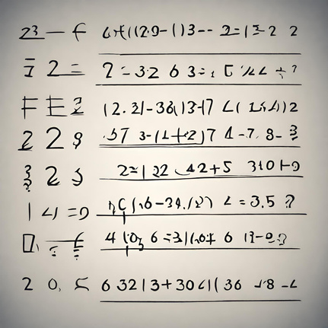
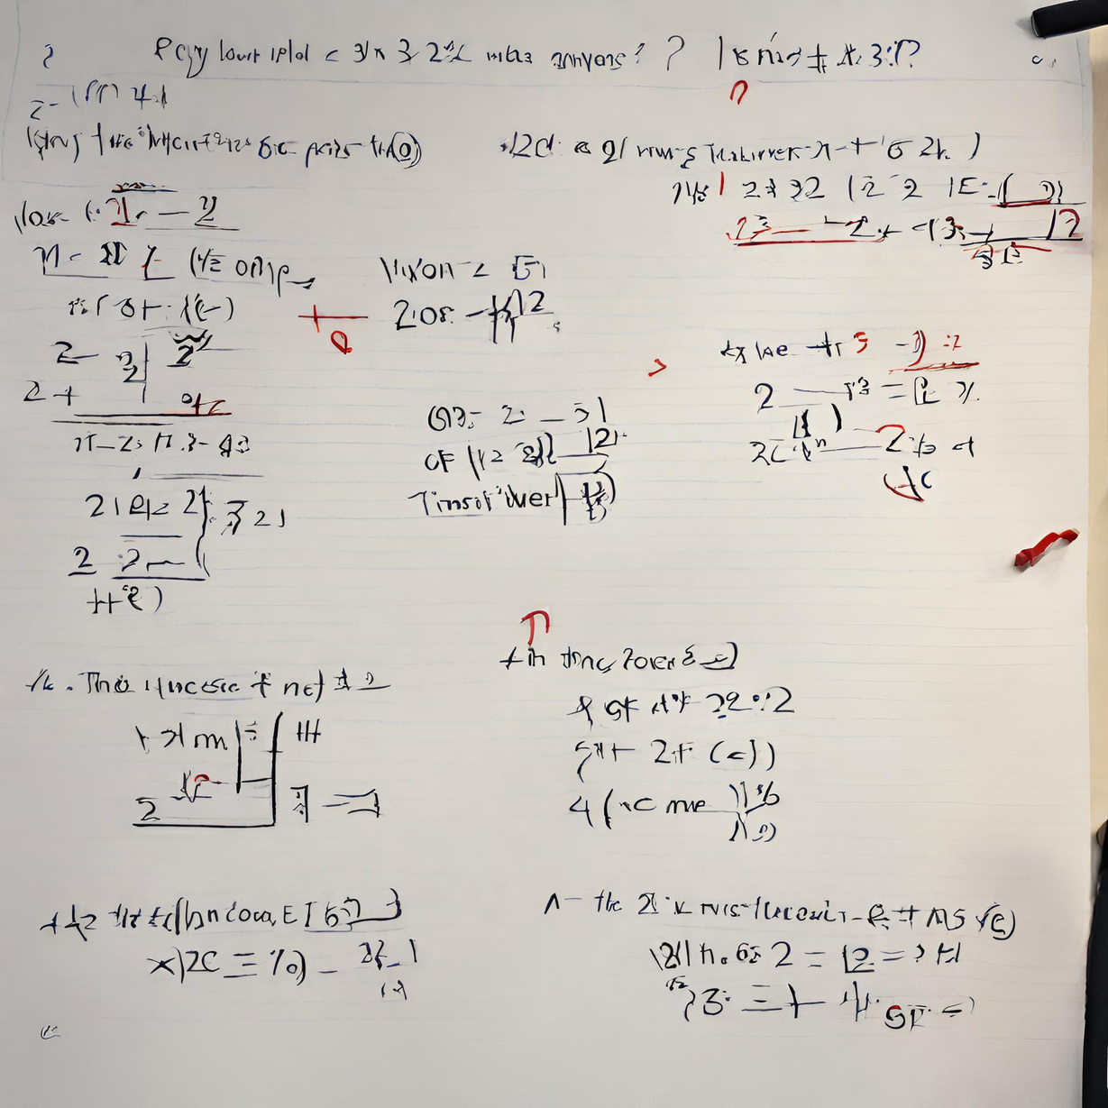
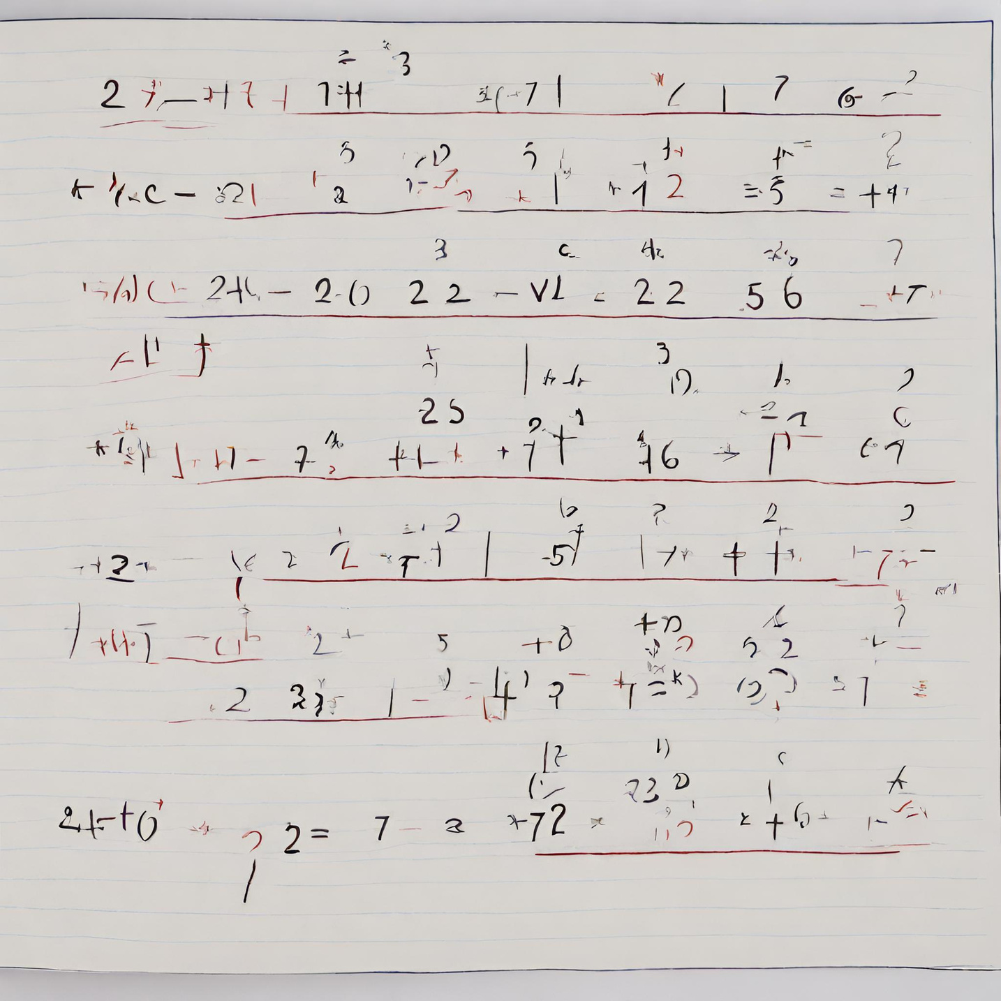
Home
About
Doubts
USER
Add your image
How to use ?
results.....
add your image
Generating results.....

Slide 11


Home
About
Doubts
Login
Your Doubts
click for full solution
click for full solution

Slide 12
Home
About
Doubts
Login
SOLUTION
click for full solution
click for full solution

Slide 13
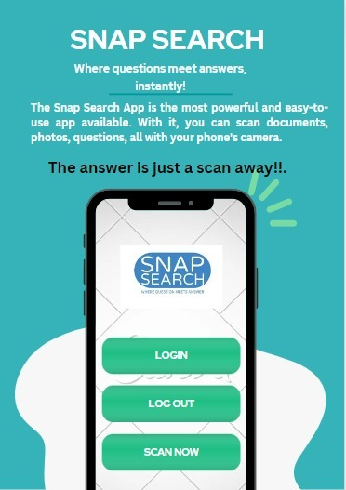

Slide 14
GITHUB LINK
https://github.com/Chinmay8897/snap-search-

Slide 15

Thank you!

